Slide 1

COS1512 – Online Class Session – 24 APRIL 2026
COS1512 – INTRODUCTION TO PROGRAMMING II – Using C++
Academic Year: 2026
Date: 24 APRIL 2026
Time: 17:00 PM to 19:00 PM

Slide 2
Topics
Chapter 2 & 3

Slide 3
Contents
Assignment Statement / Operators
Increment and Decrement Operators
Boolean Operators (both Relational and Logical)
Relational Operators
Logical Operators
Truth Table
Order of Precedence Rules
Flow of Control (Control Structures)
Sequential Control Structure
Selection Control Structure
Repetition Control Structure
break and continue statement
Nested control structures

Slide 4
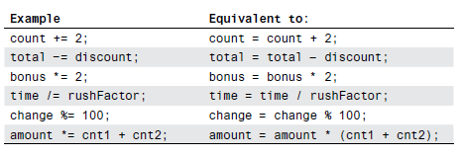
Assignment Statement / Operators
There is a shorthand notation that combines the assignment operator (=) and an arithmetic operator so that a given variable can have its value changed by adding, subtracting, multiplying by, or dividing by a specified value. The general
form is:
Variable Op = Expression
Following are examples:

Slide 5
Increment and Decrement Operators
Binary operators have two operands.
int x = 3, y= 5;
int sum = x + y; // '+' is a binary operator
Unary operators have only one operand. The C++ language has two other very common unary operators, ++ and −−. The ++ operator is called the increment operator and the −− operator is called the decrement operator. They are usually used with variables of type int. If n is a variable of type int, then n++ increases the value of n by one and n−− decreases the value of n by one.
So, n++ and n−− (when followed by a semicolon) are executable statements.
int n = 5;
n++; // equivalent to n = n + 1 = 5 + 1 = 6
int total = 0;
total--; // equivalent to total = total – 1 = 0 – 1 = – 1

Slide 6
Boolean Operators (Relational and Logical)
Boolean operators includes both relational and logical operators. Boolean (bool) values are true and false.
In C++, a Boolean expression evaluates to the bool value true when it is satisfied and to the bool value false when it is not satisfied.
The data type bool has logical (Boolean) values true and false.
bool, true, and false are reserved words.
For noting:
The identifier true has the value 1.
The identifier false has the value 0.

Slide 7
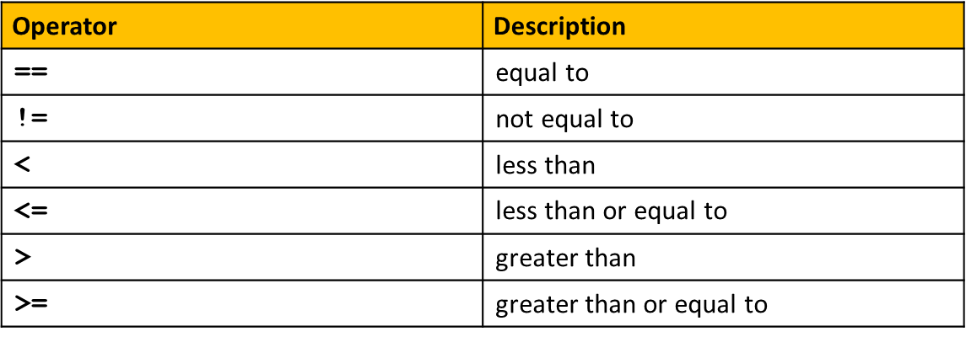
Relational Operators
The relational operators can be applied to variables for decision making and comparison purposes.

Slide 8
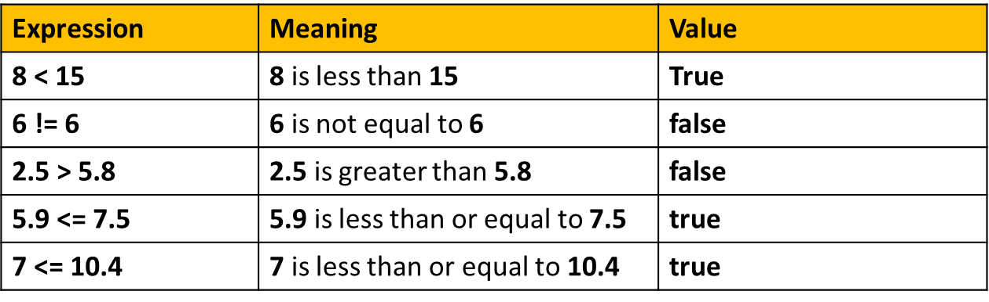
Relational Operators
Example:

Slide 9
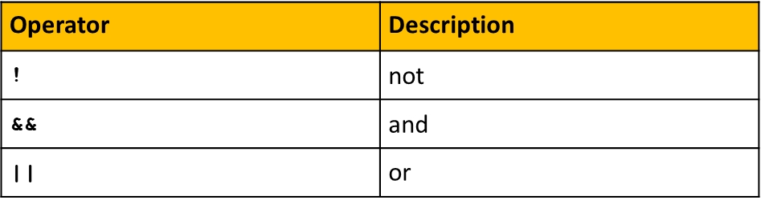
Logical Operators
Logical (Boolean) operators enable you to combine logical expressions.
In C++, the logical operators are ! (not), && (and), and || (or).

Slide 10
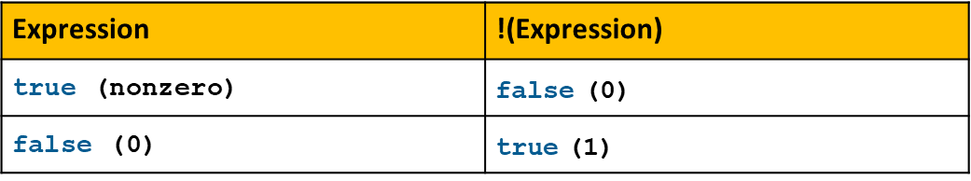
Logical Operators
! Not Operator

Slide 11
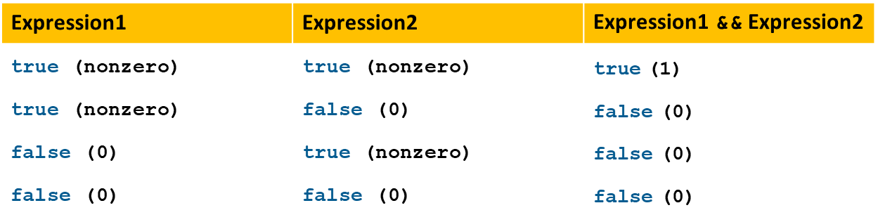
Logical Operators
&& And Operator

Slide 12
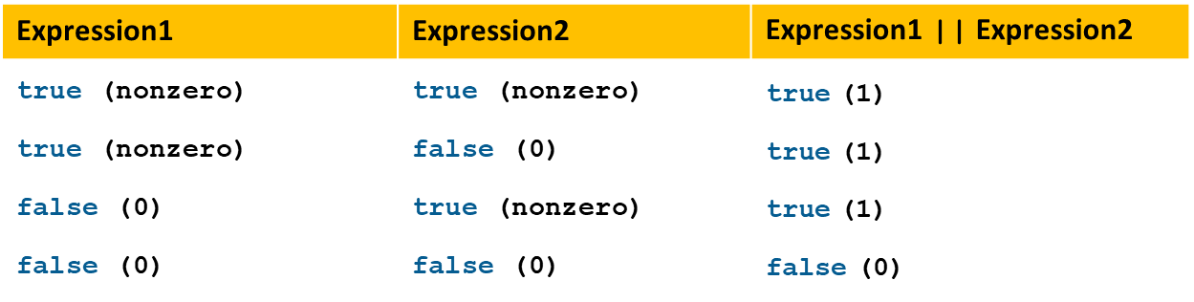
Logical Operators
|| Or Operator

Slide 13
Truth Table
A | B | A OR B | A AND B | NOT A
T | T
T | F
F | T
F | F

Slide 14
Truth Table
A | B | A OR B | A AND B | NOT A
T | T | T | T | F
T | F | T | F | F
F | T | T | F | T
F | F | F | F | T

Slide 15
Order of Precedence
When parentheses are omitted from an expression, the computer groups items according to rules known as precedence rules.
Binary operations of equal precedence are evaluated in left-to-right order. Unary operations of equal precedence are evaluated in right-to-left order.
Notice that the precedence rules include both arithmetic operators such as + and * as well as Boolean Operators (Relational operators such as <= , > and == and Logical operators such as && and ||).
Examples of expressions that can be evaluated using Precedence Order:
11 > 5 || 6 < 15 && 7 >= 8
(x + 1) > 2 || (x + 1) < −3

Slide 16
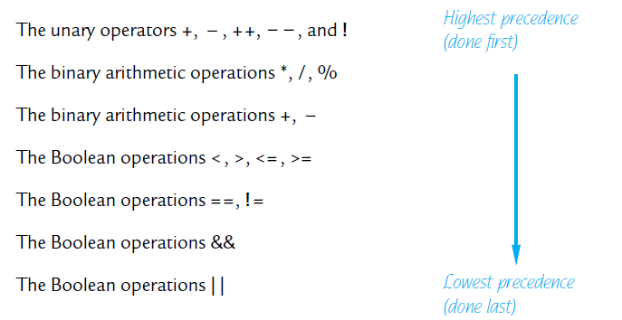
Order of Precedence Rules
Order of Precedence Rules.
If one operation is evaluated before another, the operation that is evaluated first is said to have higher precedence.
Binary operations of equal precedence are evaluated in left-to-right order. Unary operations of equal precedence are evaluated in right-to-left order.

Slide 17
Order of Precedence Rules
More into Precedence Rules:
All operations inside () are evaluated first.
*, /, and % are at the same level of precedence and are evaluated next.
+ and - have the same level of precedence and are evaluated last.
When operators are on the same level.
Operations are performed from left to right (associativity).
A Boolean expression is an expression that can be thought of as being true or false (that is, true if satisfied or false if not satisfied).
Boolean expressions can be executed from a combination of arithmetic operators, relational operators and logical operators and the given values.

Slide 18
Order of Precedence Rules
Examples following the Precedence Rules:
11 > 5 || 6 < 15 && 7 >= 8
= 11 > 5 || (6 < 15 && 7 >= 8)
= 11 > 5 || (true && false)
= 11 > 5 || (false)
= true || false
= true
Suppose x = 2
(x + 1) > 2 || (x + 1) < −3
= ((x + 1) > 2) || ((x + 1) < −3)
= ((2 + 1) > 2) || ((2 + 1) < −3)
= (3 > 2) || (3 < −3)
= true || false
= true

Slide 19
Order of Precedence Rules
Exercises:

Slide 20
Flow of Control
Three processes a computer can do:
Sequential
is the simplest flow of control
It involves executing instructions one after the other, in order, from start to finish.
It is a linear process where each step follows the previous one.
e.g. expressions, insertion and extraction operations
Selection (Branching)
Selection allows a program to make decisions based on conditions.
Depending on whether a condition is true or false, different code paths are executed.
e.g. if statement, switch statement
Repetition/Iteration (Loop)
Repetition or iteration allows a program to execute a block of code repeatedly.
Loops are used when you want to perform the same task multiple times.
e.g. while loop, do-while loop, for loop

Slide 21
Flow of Control
A computer can process a program in one of the following ways: in sequence, by executing statements one after another without using selection or repetition or functions; selectively, by making a choice, which is also called a branch; repetitively, by executing a statement over and over, using a structure called a loop; or by calling a function.
The two most common control structures are selection and repetition. In selection, the program executes particular statements depending on some condition(s). In repetition, the program repeats particular statements a certain number of times based on some condition(s).

Slide 22
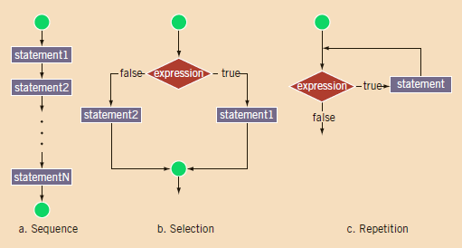
Control Structures

Slide 23
Sequential Control Structures
With such a program, the computer starts at the beginning and follows the statements in order to the end. There is no selection or looping.

Slide 24
Selection Control Structures
In selection, the program executes particular statements depending on some condition(s). The selection statements supports the use of a decision structure.
Different types of selection control structures: if, if…else (conditional operator or ternary operator), nested if…else, and switch structures / statements.

Slide 25
If Statement
Is a selection of whether or not to execute a statement or a block of statements.
Allows statements to be conditionally executed or skipped over
Models the way we mentally evaluate situations.
“If it is cold outside,
wear a coat and wear a hat.”

Slide 26
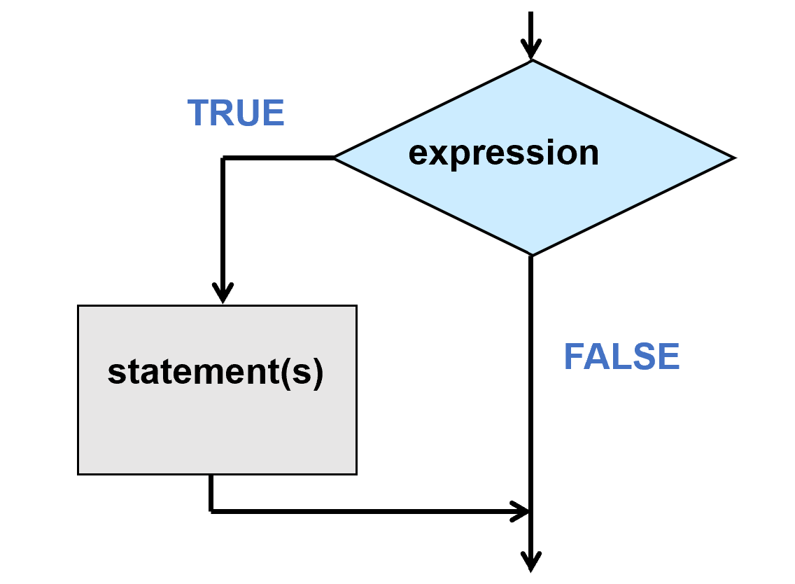
If Statement
if (expression)
Statement(s)
If expression is true, the statement executes; otherwise, the statement does not execute.

Slide 27
If Statement
Example:
int main()
{
//declare a variables
int test1Score; char grade;
cout << “Enter score: ”;
cin >> test1Score;
// test whether test1Score is greater than 60
if (test1Score > 60);
grade = ‘C’;
// display results
cout << “Test 1 score = ” << test1Score << “ and obtained grade ” << grade << endl;
return 0;
}

Slide 28
If Statement
Exercises:

Slide 29
If/Else Statement
Chain of if statements that test in order until one is found to be true.
provides selection between executing one of 2 clauses (the if clause or the else clause)
Also, models thought processes.
“If it is raining, take an umbrella,
else, if it is windy, take a hat.
else, if it is sunny, take sunglasses.
else, never mind.”

Slide 30
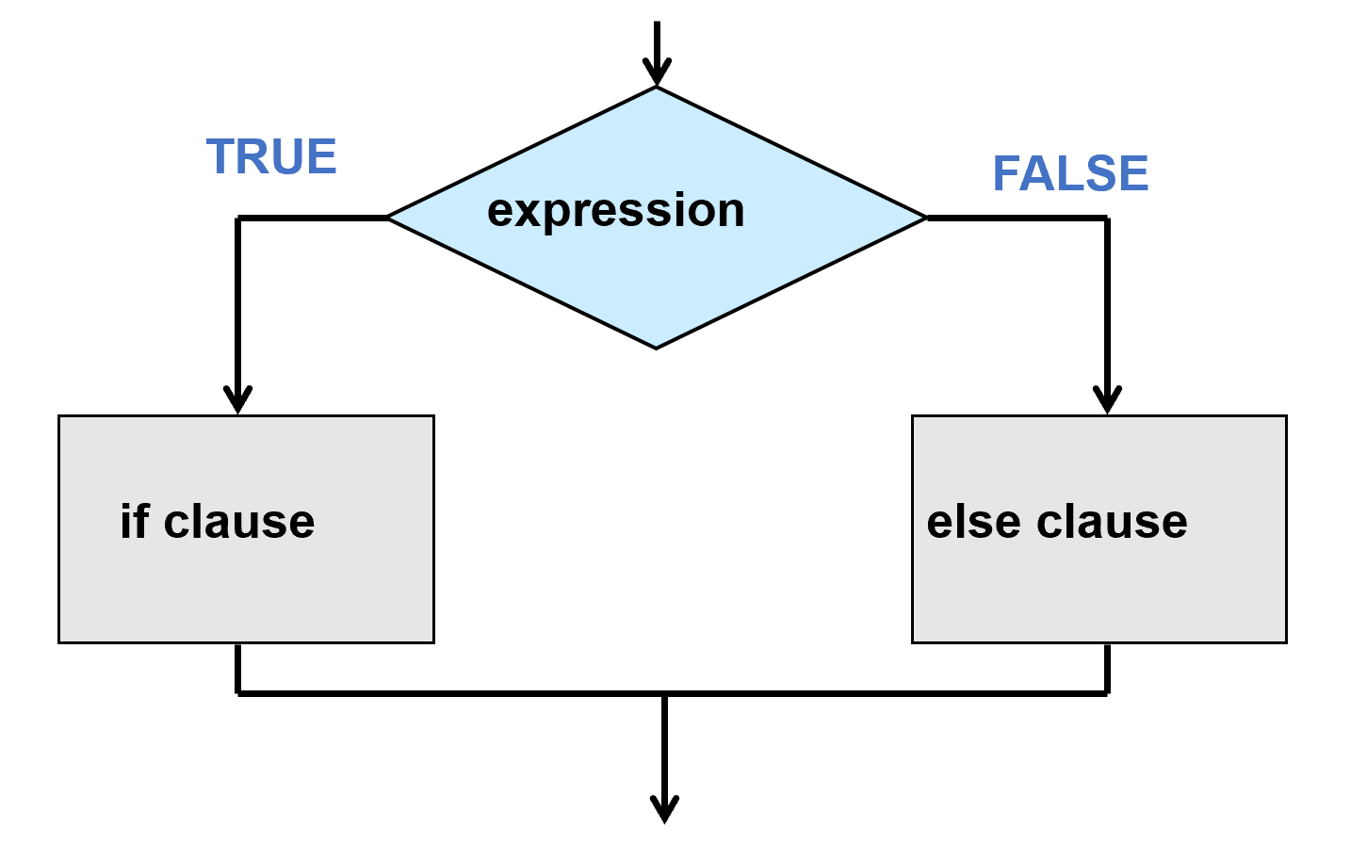
If/Else
if (expression)
Statement1(s)
else
Statement2(s)
If expression is true, then statement1 executes; otherwise, statement2 executes.

Slide 31
If/Else
Example:
int main()
{
int num1, num2, larger; //declare variables
cout << “Enter value of num1: ”;
cin >> num1;
cout << “Enter value of num2: ”;
cin >> num2;
// test whether num1 is greater than num2
if (num1 > num2);
larger = num1;
else
larger = num2;
cout << “Large value = ” << larger << endl;
return 0;
}

Slide 32
If/Else
Exercises:

Slide 33
Nested If/Else
Also called Multiway if-else Statements.
An if-else statement is a two-way branch. It allows a program to choose one of two possible actions.
Often you will want to have a three- or four-way branch so that your program can choose between more than two alternative actions. You can implement such multiway branches by nesting if-else statements.
“If it is raining, take an umbrella,
else, if it is windy, take a hat.
else, if it is sunny, take sunglasses.
else, never mind.”

Slide 34
Nested If/Else
const int number = 45;
int guess;
cin >> guess;
if (guess > number)
cout << "Too high.";
else if (guess < number)
cout << "Too low.";
else if (guess == number)
cout << "Correct!";
else
cout << "Correct!";

Slide 35
Nested If/Else
Example:
int main()
{
//declare a variables
int test1Score; char grade;
cout << “Enter score: ”;
cin >> test1Score;
// test whether test1Score is greater than 60
if (test1Score >= 80 || test1Score <= 100);
grade = ‘A’;
else if (test1Score >= 70);
grade = ‘B’;
else if (test1Score >= 60);
grade = ‘C’;
else if (test1Score >= 50);
grade = ‘D’;
else
grade = ‘H’;
// display results
cout << “Test 1 score = ” << test1Score << “ and obtained grade” << grade << endl;
return 0;
}

Slide 36
Nested If/Else
Exercises:

Slide 37
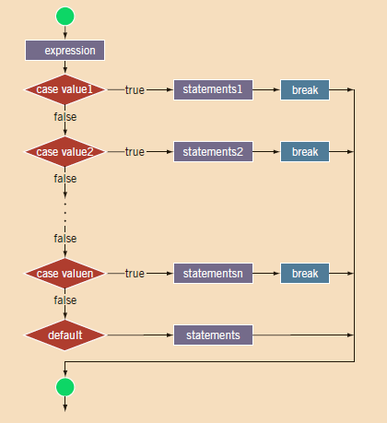
Switch Statement

Slide 38
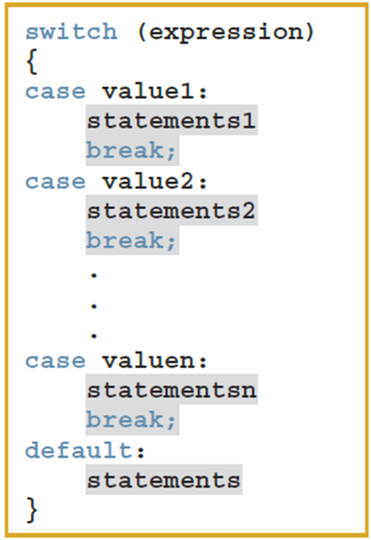
Switch Statement
In C++, switch, case, break, and default are reserved words. In a switch structure, first the expression is evaluated. The value of the expression is then used to choose and perform the actions specified in the statements that follow the reserved word case.

Slide 39
Switch Statement
Example:
int main()
{
//declare a variables
char grade;
cout << “Enter grade: ”;
cin >> grade;
switch (grade)
{
case 'A':
cout << "The grade point is 4.0.";
break;
case 'B':
cout << "The grade point is 3.0.";
break;
case 'C':
cout << "The grade point is 2.0.";
break;
case 'D':
cout << "The grade point is 1.0.";
break;
case 'F':
cout << "The grade point is 0.0.";
break;
default:
cout << "The grade is invalid.";
}
}

Slide 40
Switch Statement
Exercises:

Slide 41
Repetition Control Structures
In repetition, the program repeats particular statements a certain number of times based on some condition(s).
We refer to repetition structures as Loops. A loop is any program construction that repeats a statement or sequence of statements a number of times.
The statement (or group of statements) to be repeated in a loop is called the body of the loop, and each repetition of the loop body is called an iteration of the loop. The two main design questions when constructing loops are:
What should the loop body be?
How many times should the loop body be iterated?

Slide 42
Repetition Control Structures
There are four (4) types of repetition (loops) control structures:
While loop
Do-while loop
For loop
For each loop

Slide 43
While Loop
In a while loop, the loop is repeated while the Boolean expression in the parentheses is satisfied.
A while loop might execute its loop body zero times, which is often what you want or in case the initial testing of condition is false. Therefore, we cannot execute the body of a while loop.
If the condition to be tested is true, the statements inside the braces { and }, is called the body of the while loop, are executed in order, then they are executed again, then again, and so forth until the while loop ends.

Slide 44
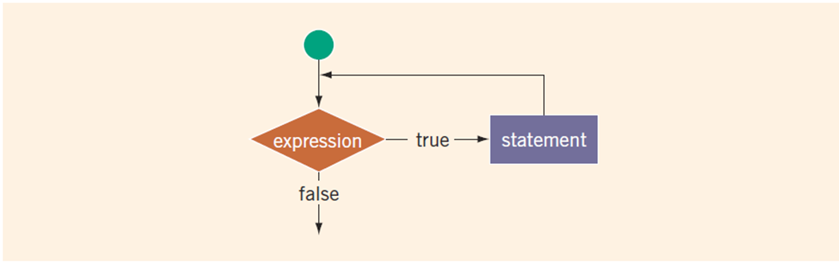
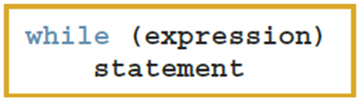
While Loop
Syntax / Structure of a While loop:
Syntax of the while statement
The expression acts as a decision maker and is usually a logical expression.
The statement is called the body of the loop
The parentheses are part of the syntax.

Slide 45
While Loop
Syntax / Structure of a while loop:
A Loop Body with a Single Statement:
while (Boolean_Expression )
Statement
A Loop Body with Several Statements must be enclosed with brackets:
while (Boolean_Expression ) {
Statement_1
Statement_2
...
Statement_Last
}

Slide 46
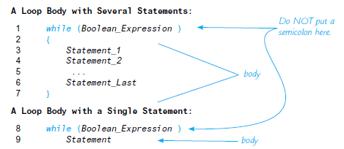
While Loop
Syntax / Structure of a while loop:

Slide 47
While Loop
Designing while Loop:
//initialize the loop control variable(s) (LVC)
while (expression) //expression tests the loop control variable
{
.
.
//update the loop control variable
.
.
}
The expression checks whether a variable, called the loop control variable (LCV), satisfies certain conditions. Various forms of while loops to be taken into consideration:
Case 1: Counter-Controlled while Loops
Case 2: Sentinel-Controlled while Loops
Case 3: Flag-Controlled while Loops
Case 4: EOF-Controlled while Loops

Slide 48
While Loop
Example of a while loop program:
int i = 0;
while (i <= 20)
{
cout << i << " ";
i = i + 5;
}
cout << endl;
The preceding while loop produces the following output:
0 5 10 15 20
The variable i is called the loop control variable (LCV).

Slide 49
While Loop
Examples:
Case 1: Counter-Controlled while Loops
When you know exactly how many times the statements need to be executed
Use a counter-controlled while loop
int counter = 0; //initialize the loop control variable
while (counter < N) //test the loop control variable
{
.
.
.
counter++; //update the loop control variable
.
.
.
}

Slide 50
While Loop
Examples:
Case 1: Counter-Controlled while Loops
When you know exactly how many times the statements need to be executed
Use a counter-controlled while loop
int i = 0; //initialize the loop control variable
while (i < 20) //test the loop control variable
{
i = i + 5; //update the loop control variable
}
cout << “Value of i = ” << i << endl;

Slide 51
While Loop
Examples:
Case 2: Sentinel-Controlled while Loops
A sentinel variable is tested in the condition. The loop ends when the sentinel is encountered.
The following is an example of a sentinel-controlled while loop:
cin >> variable; //initialize the loop control variable
while (variable != sentinel) //test the loop control variable
{
.
.
.
cin >> variable; //update the loop control variable
.
.
.
}

Slide 52
While Loop
Examples:
Case 2: Sentinel-Controlled while Loops
A sentinel variable is tested in the condition. The loop ends when the sentinel is encountered.
The following is an example of a sentinel-controlled while loop:
int num, sum = 0;
const int sentinel = -1;
cout << “Enter number: ”;
cin >> num; //initialize the loop control variable
while (num != sentinel) //test the loop control variable
{
sum = sum + num * (num + 2); //update the loop control variable
// prompt for user input and test whether the loop control variable is NOT a SENTINEL Value (-1)
cout << “Enter number again: ”;
cin >> num; //initialize the loop control variable
}
cout << “Sum = ” << sum << endl;

Slide 53
While Loop
Examples:
Case 3: Flag-Controlled while Loops
A flag-controlled while loop uses a bool variable to control the loop. A flag variable is a bool variable that indicates whether a condition is true or false. It is generally named for the true state of that condition: for example, isFound, isTallEnough, and isFull. Suppose isFound is a bool variable. The flag-controlled while loop takes the following form:
isFound = false; //initialize the loop control variable
while (!found) //test the loop control variable
{
.
.
.
If (expression)
isFound = true; //update the loop control variable
.
.
.
}

Slide 54
While Loop
Examples:
Case 3: Flag-Controlled while Loops
// Initialize the flag
bool keepLooping = true;
char userInput;
cout << "Starting the flag-controlled loop...\n";
// The loop runs as long as the flag is true
while (keepLooping) {
cout << "Enter 'q' to quit, or any other key to continue: ";
cin >> userInput;
// Update the flag based on a specific condition
if (userInput == 'q' || userInput == 'Q') {
keepLooping = false; // Changing the flag stops the loop on the next check
cout << "Flag set to false. Exiting the loop.\n";
} else {
cout << "Looping again...\n\n";
}
}

Slide 55
While Loop
Examples:
Case 4: EOF-Controlled while Loops
You can use the value returned by the input stream variable to determine whether the program has reached the end of the input data. Because the input stream variable returns the logical value true or false, in a while loop, it can be considered a logical expression. The following is an example of an EOF-controlled while loop:
cin >> variable; //initialize the loop control variable
while (cin) //test the loop control variable
{
.
.
.
cin >> variable; //update the loop control variable
.
.
.
}

Slide 56
While Loop
Examples:
Case 4: EOF-Controlled while Loops
//Declare stream variables
int num, sum = 0;
cin >> sum; //initialize the loop control variable
while (cin) //test the loop control variable
{
sum = sum + num; // add the number to sum
cin >> num; // get the next num value
}
cout << "Sum = " << sum << endl;

Slide 57
While Loop
Examples:
Case 4: EOF-Controlled while Loops
You can use the value returned by the input stream variable to determine whether the program has reached the end of the input data. Because the input stream variable returns the logical value true or false, in a while loop, it can be considered a logical expression. The following is an example of an EOF-controlled while loop:
//Declare stream variables
string studNum, studName;
double testScore, total = 0, avg;
ifstream inFile;
ofstream outFile;
inFile.open(“studData.txt"); //Open input file
outFile.open(“outputData.txt"); //Open output file
inFile >> firstName >> lastName; // read the name
inFile >> testScore; // read the test score
while (inFile) // test the loop control variable
{
total = total + testScore;
// update the loop control variable
inFile >> firstName >> lastName; // read the name
inFile >> testScore; // read the test score
}

Slide 58
While Loop
Examples:
Case 4: EOF-Controlled while Loops
The following is an example of an EOF-controlled while loop:
eof Function
In addition to checking the value of an input stream variable, such as cin, to determine whether the end of the file has been reached, C++ provides a function that you can use with an input stream variable to determine the end-of-file status. This function is called eof.
The function eof is a member of the data type istream. The syntax to use the function eof is:
istreamVar.eof()
in which istreamVar is an input stream variable, such as cin.
Suppose you have the declaration:
ifstream infile;
Further suppose that you opened a file using the variable infile. Consider the expression:
infile.eof()
This is a logical (Boolean) expression. The value of this expression is true if the program has read past the end of the input file, infile; otherwise, the value of this expression is false.

Slide 59
While Loop
Examples:
Case 4: EOF-Controlled while Loops
The following is an example of an EOF-controlled while loop:
//Declare stream variables
ifstream infile;
char ch;
infile.open("inputDat.dat");
infile.get(ch);
while (!infile.eof())
{
cout << ch;
infile.get(ch);
}
As long as the program has not reached the end of the input file, the expression:
infile.eof()
is false and so the expression: !infile.eof() in the while statement is true. When the program reads past the end of the input file, the expression:
infile.eof() becomes true, so the expression:
!infile.eof() in the while statement becomes false and the loop terminates.

Slide 60
While Loop
Exercises:
What is the output of the following (when embedded in a complete program)?
int count = 3;
while (−−count > 0)
cout << count << " ";
Suppose that the input is: 33 -10 45 -87 165 -999
What is the output of the following program?
while (num != -999)
{
cout << num % (count + 1) << " ";
cin >> num;
count++;
}
cout << endl;

Slide 61
While Loop
Exercises:
int main()
{
int num1, num2, int temp = 0;
cout << "Enter two integers: ";
cin >> num1 >> num2;
cout << endl;
while ((num1 + num2) % 2 != (num1 + num2) % 3)
{
temp = num1 + num2;
num1 = num2;
num2 = temp;
cout << temp << " ";
}
cout << " *" << endl;
return 0;
}
a. What is the output if the input is 10 10?
b. What is the output if the input is -4 11?
c. What is the output if the input is 12 29?
d. What is the output if the input is 10 17?

Slide 62
Do While Loop
If, on the other hand, you know that under all circumstances your loop body should be executed at least one time, then you can use a do-while statement. A do-while statement is similar to a while statement except that the loop body is always executed at least once.
In a do-while loop, the first thing that happens is that the statements in the loop body are executed. After that first iteration of the loop body, the do-while loop statement behaves the same as a while loop. The Boolean expression is checked. If the Boolean expression is true, the loop body is executed again; the Boolean expression is checked again, and so forth.

Slide 63

Do While Loop
Syntax / Structure of a do-while loop:
A Loop Body with Several Statements:
do
{
Statement_1
Statement_2
...
Statement_Last
} while (Boolean_Expression);
A Loop Body with a Single Statement:
do
Statement
while (Boolean_Expression);

Slide 64
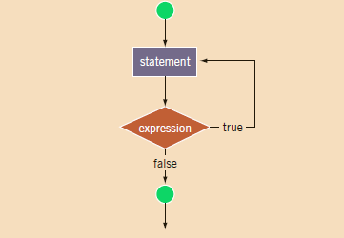
Do While Loop
Syntax / Structure of a do-while loop:
The statement executes first, and then the expression is evaluated. If the expression evaluates to true, the statement executes again. As long as the expression in a do. . .while statement is true, the statement executes. To avoid an infinite loop, you must, once again, make sure that the loop body contains a statement that ultimately makes the expression false and assures that it exits properly.
Syntax of a do-while loop:

Slide 65
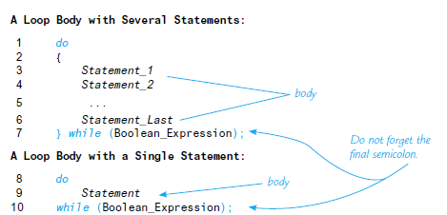
Do While Loop
Syntax / Structure of a do-while loop:

Slide 66
Do While Loop
Examples:
int i = 0;
do
{
cout << i << " ";
i = i + 5;
}
while (i <= 20);
The output of this code is:
0 5 10 15 20
After 20 is output, the statement:
i = i + 5;
changes the value of i to 25 and so i <= 20 becomes false, which halts the loop.

Slide 67
Do While Loop
Examples:
A do. . .while loop can be used for input validation. Suppose that a program prompts a user to enter a test score, which must be greater than or equal to 0 and less than or equal to 50. If the user enters a score less than 0 or greater than 50, the user should be prompted to re-enter the score. The following do...while loop can be used to accomplish this objective:
int score;
do
{
cout << "Enter a score between 0 and 50: ";
cin >> score;
cout << endl;
} while (score < 0 || score > 50);

Slide 68
Do While Loop
Exercises:
What is the output of the following (when embedded in a complete program)?
int n = 1;
do
cout << n << " ";
while (++n <= 3);
What is the output of the following program segment?
int count = 1;
do
cout << count * (count - 2) << " ";
while (count++ <= 5);
cout << endl;

Slide 69
Do While Loop
Exercises:
The do...while loop in the following program is supposed to read some numbers until it reaches a sentinel (in this case, -1). It is supposed to add all of the numbers except for the sentinel. If the data looks like: 12 5 30 48 -1
the program does not add the numbers correctly. Correct the program so that it adds the numbers correctly.
#include <iostream>
using namespace std;
int main()
{
int total = 0, count = 0, number;
do
{
cin >> number;
total = total + number;
count++;
} while (number != -1);
cout << "The number of data read is " << count << endl;
cout << "The sum of the numbers entered is " << total << endl;
return 0;
}

Slide 70
For Loop
The while loop is general enough to implement most forms of repetitions. The C++ for looping structure discussed here is a specialized form of the while loop. Its primary purpose is to simplify the writing of counter-controlled loops.

Slide 71
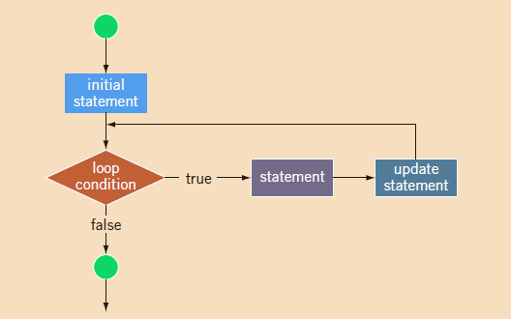
For Loop
Syntax / Structure of a For loop:
The for loop executes as follows:
1. The initial statement executes.
2. The loop condition is evaluated. If the loop condition evaluates to true:
i. Execute the for loop statement.
ii. Execute the update statement (the third expression in the parentheses).
3. Repeat Step 2 until the loop condition evaluates to false.
The initial statement usually initializes a variable (called the for loop control, or for indexed, variable).

Slide 72
For Loop
Examples:
You can increment (or decrement) the loop control variable by any fixed number. In the following for loop, the variable is initialized to 1; at the end of the for loop, i is incremented by 2. This for loop outputs the first 10 positive odd integers.
for (i = 1; i <= 20; i = i + 2)
cout << " " << i;
cout << endl;
The output is:
1 3 5 7 9 11 13 15 17 19

Slide 73
For Loop
Examples:
You can count backward using a for loop if the for loop control expressions are set correctly.
For example, consider the following for loop:
for (i = 10; i >= 1; i--)
cout << " " << i;
cout << endl;
The output is:
10 9 8 7 6 5 4 3 2 1
sum = 0;
for (n = 1; n <= 10; n++)
sum = sum + n;

Slide 74
For Loop
Examples:
In this example, a for loop reads five numbers and finds their sum and average.
Consider the following program code, in which i, newNum, sum, and average are int variables:
int sum = 0; double average;
for (i = 1; i <= 5; i++)
{
cout << “Enter number: ”;
cin >> newNum;
sum = sum + newNum;
}
average = sum / 5;
cout << "The sum is " << sum << endl;
cout << "The average is " << average << endl;
After reading a newNum, this value is added to the previously calculated (partial) sum of all the numbers read before the current number. The variable sum is initialized to 0 before the for loop. Thus, after the program reads the first number and adds it to the value of sum, the variable sum holds the correct sum of the first number.

Slide 75
For Loop
Exercises:
What is the output of the following (when embedded in a complete program)?
for (int n = 10; n > 0; n = n - 2)
{
cout << "Hello ";
cout << n << endl;
}
Rewrite the following loops as for loops.
a. int i = 1;
while (i <= 10)
{
if (i < 5 && i != 2)
cout << 'X’;
i++;
}
b. int i = 1;
while (i <= 10)

Slide 76
For Each Loop
For each item in list of items do something. For each loop is used most in arrays, lists, array lists, etc.
for(item: items)
// do somethings

Slide 77
break and continue Statements:
break Statement:
The break statement, when executed in a switch structure, provides an immediate exit from the switch structure. Similarly, you can use the break statement in while, for, and do. . .while loops to immediately exit from the loop structure. The break statement is typically used for two purposes:
To exit early from a loop.
To skip the remainder of the switch structure.
After the break statement executes, the program continues to execute with the first statement after the structure. The use of a break statement in a loop can eliminate the use of certain (flag) variables.
You have already used the break statement as a way of ending a switch statement. This same break statement can be used to exit a loop. Sometimes you want to exit a loop before it ends in the normal way. For example, the loop might contain a check for improper input and if some improper input is encountered, then you may want to simply end the loop.

Slide 78
break and continue Statements:
continue Statement:
Executing a break statement in the body of a loop immediately terminates the loop.
Executing a continue statement in the body of a loop skips the loop’s remaining statements and proceeds with the next iteration.
When a continue statement executes in a while or do. . .while loop, the expression update statement in the body of the loop may not execute.
After a continue statement executes in a for loop, the update statement is the next statement executed.

Slide 79
Examples
break and continue Statements:
Example 1: Break
int num = 12;
while (num >= 0)
{
if (num % 5 == 0)
break;
cout << num << " ";
num = num - 2;
}
cout << endl;
Example 2: Continue
int num = 12;
while (num >= 0)
{
if (num % 5 == 0)
{
num++;
continue;
}
cout << num << " ";
num = num - 2;
}
cout << endl;

Slide 80
break and continue Statements:
Exercises:
What does a break statement do in a loop?
What does a continue statement do in a loop?
What is the output of the following code?
int num = 12;
while (num >= 0)
{
if (num % 5 == 0)
{
num++;
continue;
}
cout << num << " ";
num = num - 2;
}
cout << endl;

Slide 81
break and continue Statements:
Exercises:
What is the output of the following code?
int num = 12;
while (num >= 0)
{
if (num % 5 == 0)
{
num++;
continue;
}
cout << num << " ";
num = num - 2;
}
cout << endl;

Slide 82
Nested Control Structures:
In programming, a nested control structure occurs when you place one control structure (like a for loop, while loop, or if statement) inside another.
Nested control structures are needed in coding when a problem requires one decision or loop inside another decision or loop. They help programmers handle complex situations step by step.

Slide 83
Nested Control Structures:
Examples:
Suppose you want to create the following pattern:
*
**
***
****
*****
You can use the value of i as the limiting condition in another for loop nested within this loop to control the number of stars in a line.
for (i = 1; i <= 5; i++)
{
for (j = 1; j <= i; j++)
cout << "*";
cout << endl;
}

Slide 84
Nested Control Structures:
Examples (pg. 192):
The program in Display 3.15 was designed to help track the reproduction rate of the green-necked vulture, an endangered species. In the district where this vulture survives, conservationists annually perform a count of the number of eggs in green-necked vulture nests. The program in Display 3.15 takes the reports of each of the conservationists in the district and calculates the total number of eggs contained in all the nests they observed.
Each conservationist’s report consists of a list of numbers. Each number is the count of the number of eggs observed in one green-necked vulture nest.
The program reads in the report of one conservationist and calculates the total number of eggs found by this conservationist. The list of numbers for each conservationist has a negative number added to the end of the list. This serves as a sentinel value. The program loops through the number of reports and calculates the total number of eggs found for each report.

Slide 85
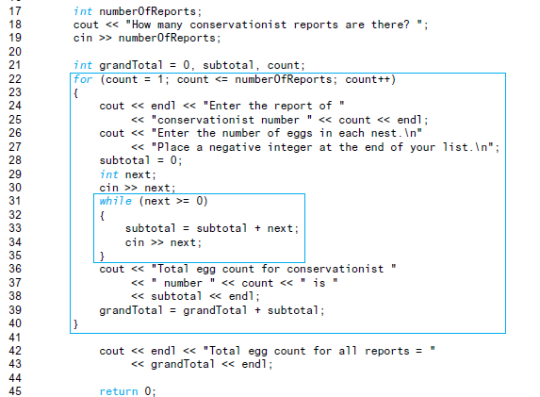
Nested Control Structures:
Examples (pg. 192):

Slide 86
Nested Control Structures:
Exercises:
Suppose that the input is 20 -16 -5 15 6 0.
What is the output of the following code?
int num;
int temp = 0;
cin >> num;
while (num != 0)
{
if (num % 2 == 0)
temp = temp + num;
else
temp = temp - num;
cin >> num;
}
cout << "temp = " << temp << endl;

Slide 87
Nested Control Structures:
Exercises:
Predict the output of the following nested loops:
int n, m;
for (n = 1; n <= 10; n++)
for (m = 10; m >= 1; m −−)
cout << n << " times " << m
<< " = " << n * m << endl;

Slide 88
Nested Control Structures:
Exercises: Classifying Numbers
This program reads a given set of integers and then prints the number of odd and even integers. It also outputs the number of zeros.
The program reads 20 integers, but you can easily modify it to read any set of numbers.
In fact, you can modify the program so that it first prompts the user to specify how many integers are to be read.
Input 20 integers—positive, negative, or zeros.
Output The number of zeros, even numbers, and odd numbers.
Hint: Use for loop and switch statement.

Slide 89
Useful Resources on OOP
Useful Resources
Prescribed Book:
Savitch, W., & Mock, K. (2018). Problem solving with C++ (10th ed.). Pearson.
Recommended Book:
Malik, D. S. (2018). C++ programming: Program design including data structures (8th ed.). Cengage Learning.

Slide 90
Useful Resources on OOP
Additional Resources:
YouTube Videos
If…else and nested if else in C++
https://www.youtube.com/watch?v=6eq3jb7_jaM&list=PLBlnK6fEyqRipr0TpZ39rBn4mUrSQbXlC
Switch statement in C++
https://www.youtube.com/watch?v=OPKpGsvBtBg&list=PLBlnK6fEyqRipr0TpZ39rBn4mUrSQbXlC&index=2
for, while, and do…while loops in C++
https://www.youtube.com/watch?v=j4DB4u5u91g&list=PLBlnK6fEyqRipr0TpZ39rBn4mUrSQbXlC&index=3
break and continue Statements in C++
https://www.youtube.com/watch?v=hDGaCLETGYc&list=PLBlnK6fEyqRipr0TpZ39rBn4mUrSQbXlC&index=4

Slide 91
Useful Resources on OOP
Web Resources:
https://www.geeksforgeeks.org/computer-science-fundamentals/control-flow-statements-in-programming/
https://www.codecademy.com/learn/c-plus-plus-for-programmers/modules/control-flow-cpp/cheatsheet
https://www.w3schools.com/cpp/cpp_conditions.asp

